Slide 1
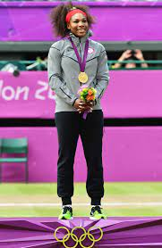
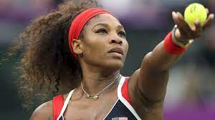
SERENA WILLIAMS

Slide 2
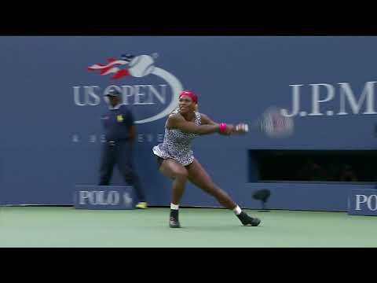

Slide 3
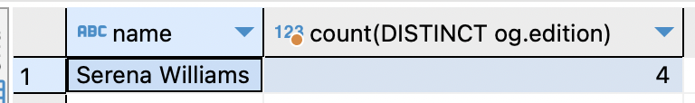
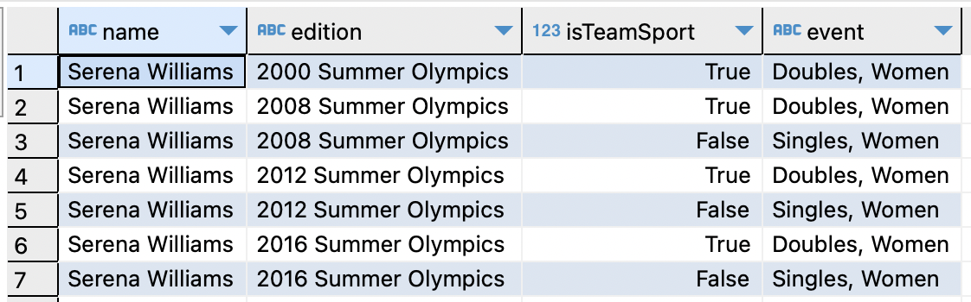
Total Olympic Games

Slide 4
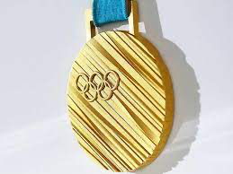
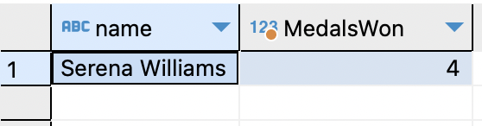
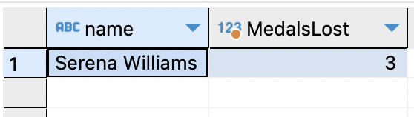
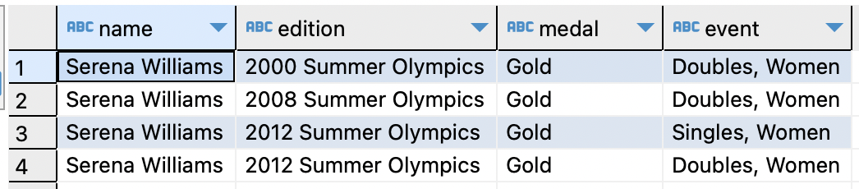
Won 4 Gold Medals!

Slide 5
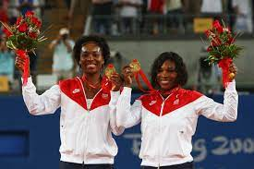
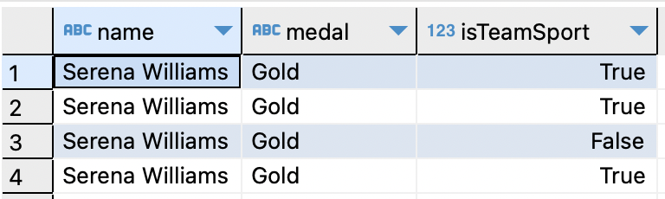
SERENA AND VENUS WILLIAMS: SISTERS AND RIVALS

Slide 6
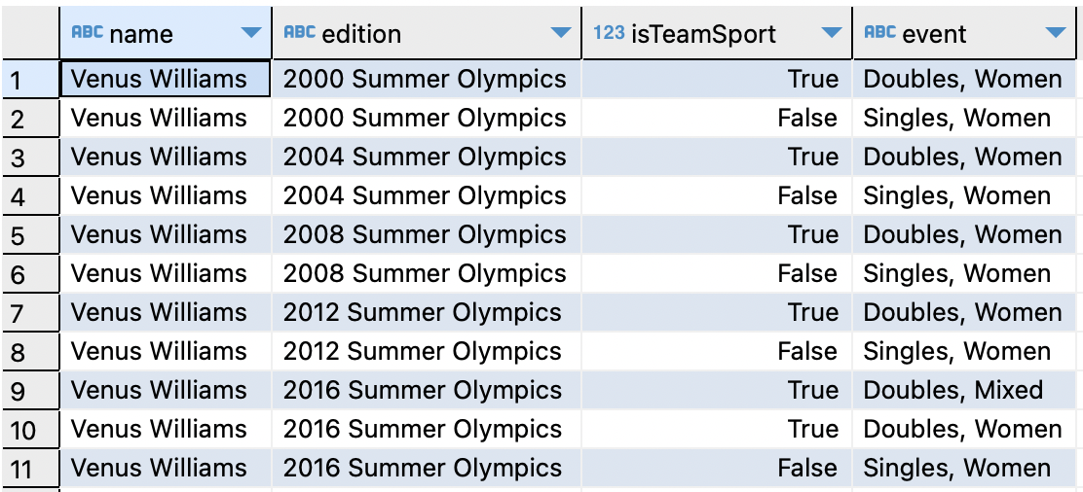

Comparison of Serena and Venus Olympics Appearances

Slide 7
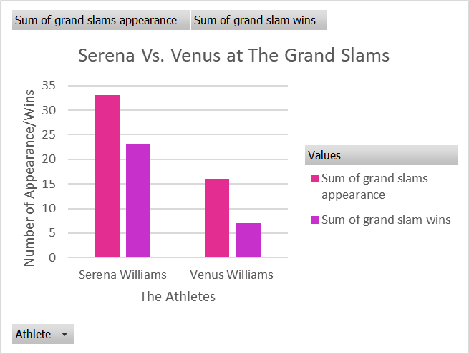
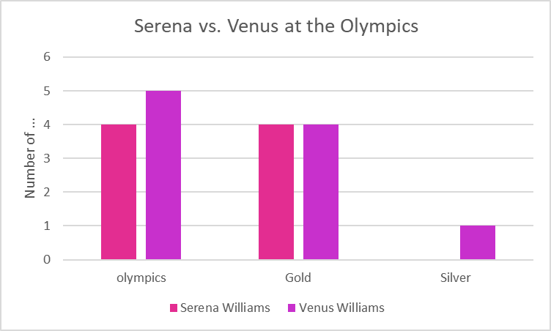
Comparison of Serena and Venus Olympics and Grand Slams

Slide 8
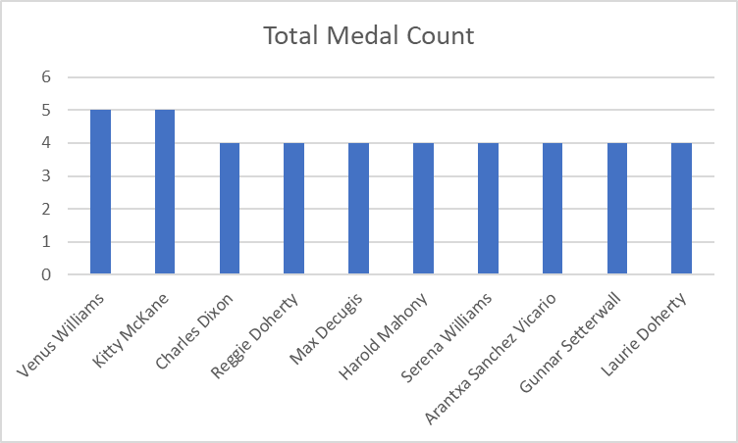
Serena Williams vs. Tennis Rivals

Slide 9

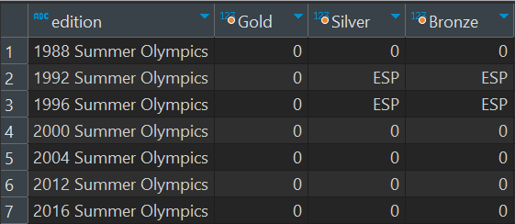
Kitty McKane and Arantxa Sanchez
SELECT edition,
max(CASE WHEN medal = 'Gold' THEN country_noc ELSE 0
END) AS Gold,
max(CASE WHEN medal = 'Silver' THEN country_noc ELSE 0
END) AS Silver,
MAX(CASE WHEN medal = 'Bronze' THEN country_noc ELSE 0
END) AS Bronze
FROM Olympic_Athlete_Event_Results oaer
WHERE sport = 'Tennis' AND athlete LIKE '%Arantxa%'
GROUP BY edition
ORDER BY edition

Slide 10

A TRIBUTE TO SERENA WILLIAMS

